Slide 1
Intro to Java WS
Rajeev Gupta MTech CS
Rgupta.mtech@gmail.com

Slide 2
Agenda
WS vs. Web applications
Introduction to WS
Introduction to SOAP, WSDL, UDDI, SEI
Introduction to JAX-WS 2.x
Hello World WS

Slide 3
Agenda
WS vs. Web applications
Introduction to WS
Introduction to SOAP, WSDL, UDDI, SEI
Introduction to JAX-WS 2.x
Hello World WS

Slide 4
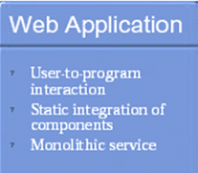
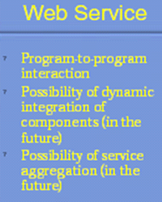
WS vs. Web applications
Two type of Web applications:-
Presentation-oriented: H to M
A presentation-oriented web application generates interactive web pages containing various types of mark-up language (HTML, XML etc.) and dynamic content in response to requests.
Service-oriented: M to M
A service-oriented web application implements the endpoint of a web service.
Presentation-oriented applications are often clients of service-oriented web applications.

Slide 5
Agenda
WS vs. Web applications
Introduction to WS
Introduction to SOAP, WSDL, UDDI, SEI
Introduction to JAX-WS 2.x
Hello World WS

Slide 6
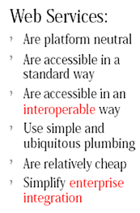
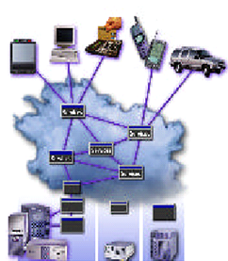
Introduction to WS
What is WS?
Web services are Web-based enterprise applications that use open, XML-based standards and transport protocols to exchange data with calling clients
Distributed Applications
Why WS?
Application Area
Data Provider, B2B, EAI
Type of WS?
SOAP based, RESTful
Feature of WS?
have No UI
Interacts with applications (M to M)
Works with any browser client

Slide 7
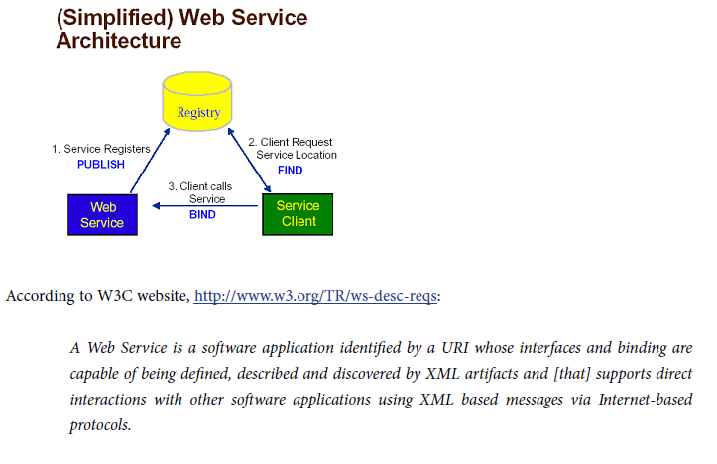
Simplified WS Architecture

Slide 8
Agenda
WS vs. Web applications
Introduction to WS
Introduction to SOAP, WSDL, UDDI, SEI
Introduction to JAX-WS 2.x
Hello World WS

Slide 9
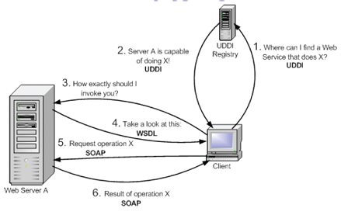
Introduction to SOAP, WSDL, UDDI
Three key components of SOAP based WS
UDDI (Universal Description, Discovery and Integration)
WSDL (Web Services Description Language)
SOAP (Simple Object Access Protocol)

Slide 10
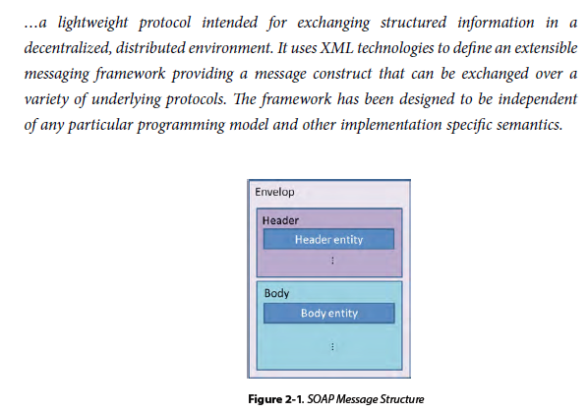
SOAP

Slide 11
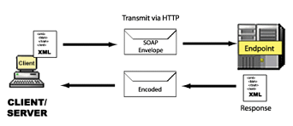
SOAP
How to pass java String to C++ application ; exchange of data?
SOAP works same as marshalling/unmarshling in RMI
SOAP format aka xml format
What C++ app does with java serialized data?
XML protocol that all to transmit data between client and service provider

Slide 12
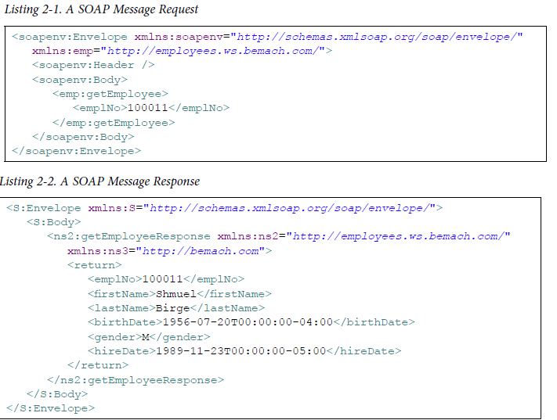
SOAP request response

Slide 13
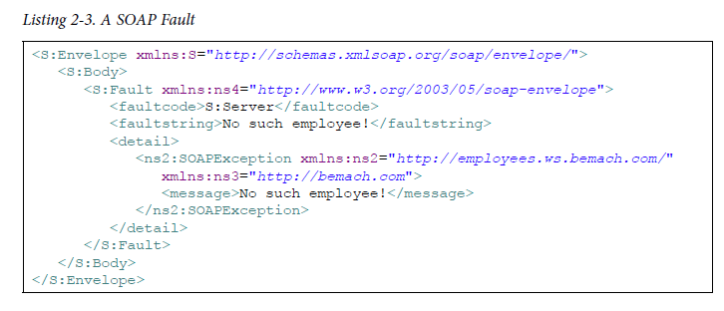
SOAP Fault

Slide 14
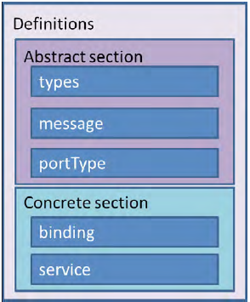
WSDL
Lets say we have a ws , how we could share details of our customer?
How to provide an interface (contract) to the consumer and that language independent too! (Interoperability)
WSDL describing the following:-
What a service does
the methods that the service provides
How a service is accessed
details of the data formats and
protocols necessary to access a service operations
Where a service is located?
details of the protocol specific network address, such as a URL

Slide 15
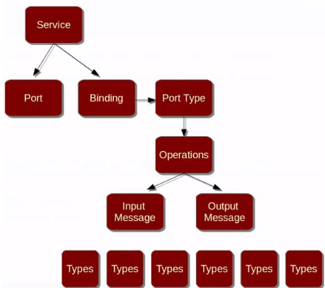
WSDL consists of two parts
abstract interface
Types?
Describes the XML types & elements that are used in the messages to/from the web services
Messages?
Describes the input, output and fault messages that comes into and goes out of web service operations
PortType?
Names the web service and describes the operations offered by the web service
concrete implementation
concrete implementation part binds the abstract interface with a concrete network address
Bindings?
Describes the transport protocol like HTTP to carry the SOAP envelope for communicating with web service
Service?
Describes the endpoint where the service is really available for consumption

Slide 16
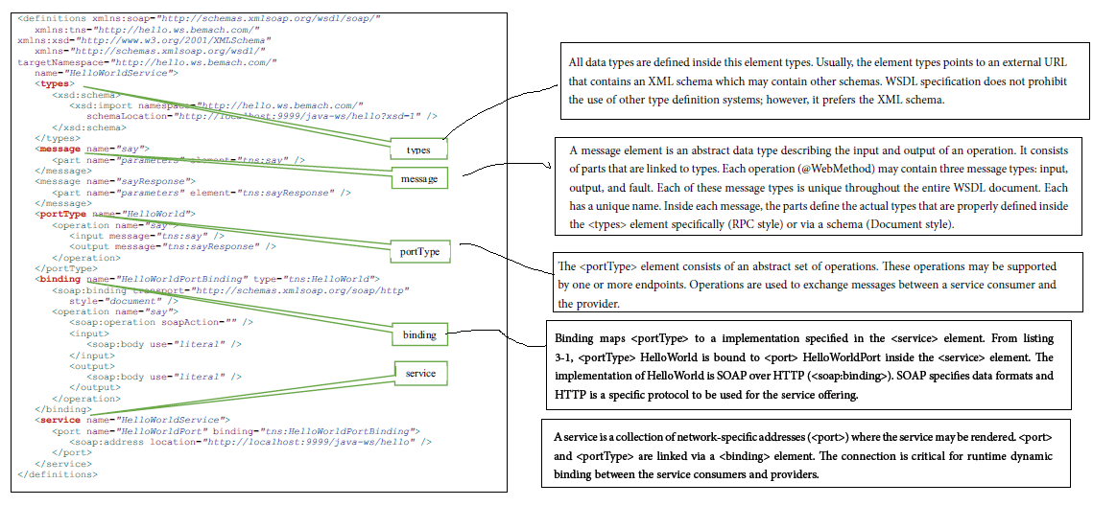
Understanding WSDL

Slide 17
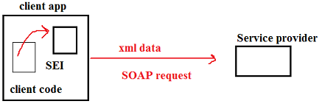
Service Endpoint Interface SEI
Who does the conversion ; form Java object to SOAP objects?
Conversion is done by SEI (Service end point interface)
SEI Translate whole ws call to SOAP ; so that other side can understand it
SEI is specific to application to client side; we need different SEI to handle C++ client and different one for php client
tools generate it; wsimport
It translate java call to ws call !

Slide 18
Agenda
WS vs. Web applications
Introduction to WS
Introduction to SOAP, WSDL, UDDI, SEI
Introduction to JAX-WS 2.x
Hello World WS

Slide 19
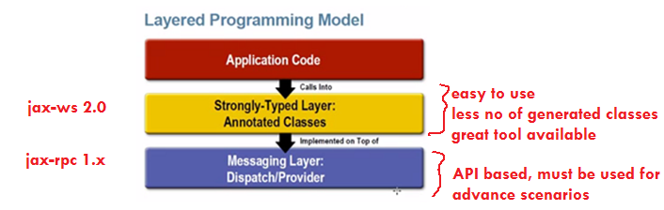
JAX-WS 2.0
What is JAX-WS 2.0?
Simpler way to create & deploy SOAP based WS compared to JAX-WS 1.0 ( JAX-RPC)
API stack for web services.
New API’s: JAX-WS, SAAJ, Web Service metadata
New packages: javax.xml.ws, javax.xml.soap, javax.jws
Why JAX-WS 2.0?
POJO based
No DD
Layered programming model
Both Java SE and Java EE support
Build in data binding using JAXB 2.0
Protocol and Transport independent

Slide 20
Creating JAX WS
Two approaches
Contract first / top down / WSDL first approach
We start with WSDL
wsimport tool: WSDL to java code
Contract last / bottom up/ code first approach
annotated POJO => Build and deploy
wsgen tool to generate wsdl from java code

Slide 21
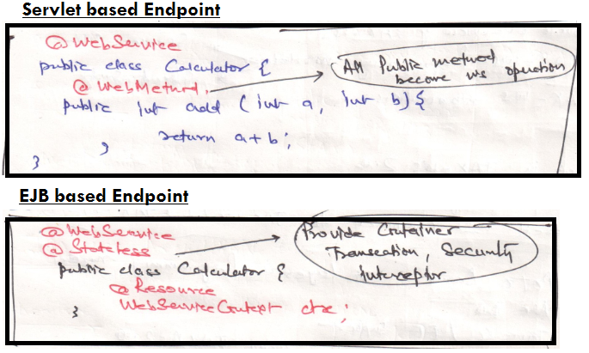
Contract last approach
Steps Contract fist Approach:
Write POJO implementing the service
Add @WebService annotation on that
Optionally inject WebServiceContext
Deploy application
Point your client at WSDL
What is webServiceContext?
used for server side DI, provides:
1. Security Info ( getUserPrincipal)
2. Message context ( Bag of properties contain data that is not part of xml payload)

Slide 22
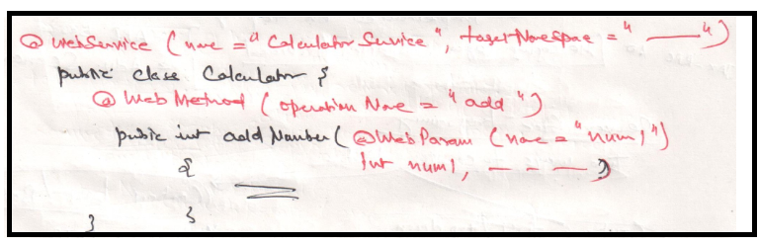
@WebService, @WebParam
@WebService
Marks a java class as implementing a web service, or a Java interface as defining a web service interface
Attributes
endpointInterface : used in implementation class
Name: mapped to wsdl:portType
serviceName : mapped to wsdl:service
targetNamespace
wsdlLocation
URL ( relative or absolute ) that refer to an pre-existing WSDl file
@WebParam
Customizes the mapping of an individual parameter to a web service messsage part and XML element
Attribute:
name
partName
targetNamespace
header
model

Slide 23
Agenda
WS vs. Web applications
Introduction to WS
Introduction to SOAP, WSDL, UDDI, SEI
Introduction to JAX-WS 2.x
Hello World WS

Slide 24
CalculatorWS example
import javax.jws.WebService;
import javax.jws.WebMethod;
import javax.jws.WebParam;
@WebService(serviceName = "CalculatorWS")
public class CalculatorWS {
@WebMethod
public int add (@WebParam (name= "value1") int value1, @WebParam( name="value2" ) int value2){
return value1 + value2;
}
}
Declare that method add is a WebMethod
Specify parameter names

Slide 25
Requirements of a JAX-WS Endpoint
The implementing class must be annotated with the @WebService or @WebServiceProvider annotation
The business methods of the implementing class must be public.
The business methods must not be declared static or final.
Business methods that are exposed to web service clients must be annotated with @WebMethod.
Business methods that are exposed to web service clients must have JAXB-compatible parameters and return types.
See the list of JAXB default data type bindings at
http://docs.oracle.com/javaee/5/tutorial/doc/bnazq.html#bnazs.

Slide 26
Coding the SEI implementation Class
@WebService annotation at the beginning of each new web service class you create
Optional element name
specifies the name of the proxy class that will be generated for the client
Optional element serviceName
specifies the name of the class to obtain a proxy object
@WebMethod annotation at the beginning of each method that is exposed as a WSDL operation
Methods that are tagged with the @WebMethod annotation can be called remotely
Methods that are not tagged with @WebMethod are not accessible to clients that consume the web service
@WebParam annotation is used here to control the name of a parameter in the WSDL
Without this annotation the parameter name = arg0

Slide 27
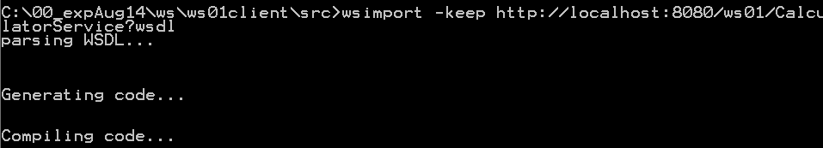
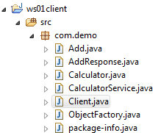

Web service client
From src of client project
wsimport -keep http://localhost:8080/hello-ws/CalculatorService?wsdl
What is wsimport ?
The wsimport command-line tool processes an existing WSDL file and generates the required portable support classes (SEI) for developing JAX-WS web service applications
Essentially, it is going to automatically generate all of the class files involved with the SOAP, XML and communication aspects of our web service!

Slide 28
Coding the SEI implementation Class
@WebService annotation at the beginning of each new web service class you create
Optional element name
specifies the name of the proxy class that will be generated for the client
Optional element serviceName
specifies the name of the class to obtain a proxy object
@WebMethod annotation at the beginning of each method that is exposed as a WSDL operation
Methods that are tagged with the @WebMethod annotation can be called remotely
Methods that are not tagged with @WebMethod are not accessible to clients that consume the web service
@WebParam annotation is used here to control the name of a parameter in the WSDL
Without this annotation the parameter name = arg0

Slide 29
JAX WS annotations
@javax.jws.WebService
Marks a Java interface as a Service Endpoint Interface.
Marks a Java class as a web service endpoint implementation.
@javax.jws.WebMethod
Optional annotation for customizing a SOAP web service operation
@javax.jws.WebParam
Optional annotation for customizing the mapping of an individual parameter to a web service message part, or input parameter.
@javax.jws.WebResult
Optional annotation for customizing how SOAP treats the output of a web operation.
@javax.jws.soap.SOAPBinding
Customizes the mapping of the web service onto the SOAP message protocol.
Its use is optional as the default settings are the recommended values and will make your web service the most portable.

Slide 30
package com.demo.ws;
import java.util.List;
import javax.jws.*; // General web service annotations
import javax.jws.soap.*; // SOAP-specific WS annotations
@SOAPBinding(
style = SOAPBinding.Style.DOCUMENT,
use = SOAPBinding.Use.LITERAL,
parameterStyle = SOAPBinding.ParameterStyle.WRAPPED)
@WebService(
targetNamespace = "http://www.raj.com")
public interface UserService {
@WebMethod(action = "CreateExample")
public User getUser(@WebParam(name = "username") String username);
}

Slide 31
Why WS.*
Online Shopping Application
Banks
Payment Gateway
Web Service
Soap Body?
Soap Header?
What are element Names?

Slide 32
WS-Security
Authentication
User Name Token Profile
X 508 Certificates
SAML
Confidentiality
Encryption and Decryption
Integrity
XML Signature

Slide 33
MTOM - For exchanging files
WS-Addressing - Asynchronous Callbacks
WS-Policy- Assert and mandate certain rules to consume our web services.
WS-SecureConversation - Improve Performance while encrypting and decrypting by negotiating a key at the beginning.
WS-SecurityPolicy - Assert WS-Security requirements.

